Slide 1


ERSI 904
Enjeux énergétiques, labels, réglementation et STD
Energy calculations, labels and regulations
Simon Rouchier

Slide 2
Bioclimatic houses Christophe Ménézo
Energy labels Mickaël Pailha
Heat transfer and HVAC calculations Simon Rouchier
Session | Day | Time
1 | 15/11/17 | 8h15
2 | 15/11/17 | 10h00
3 | 16/11/17 | 8h15
4 | 20/11/17 | 13h30
5 | 20/11/17 | 15h15
6 | 24/11/17 | 8h15
7 | 24/11/17 | 10h00
8 | 27/11/17 | 13h30
9 | 27/11/17 | 15h15
<numéro>

Slide 3





Building construction characteristics
1. Heat transfer calculations
Heating and cooling loads ; latent loads
2. Sizing HVAC systems
3. Humidity and AHUs
4. Control systems
<numéro>

Slide 4
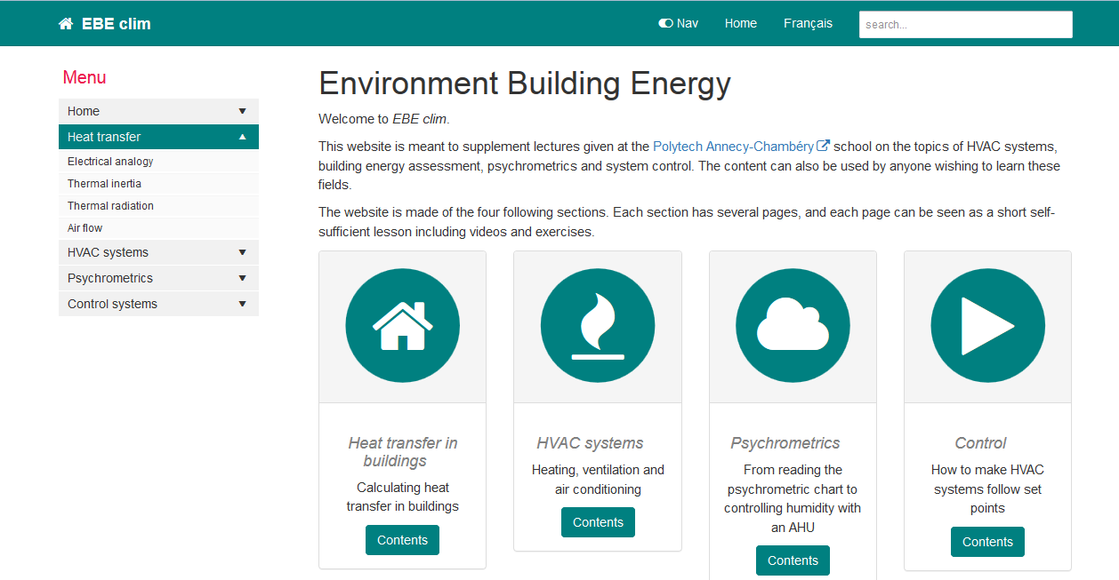
http://ebeclim.org
<numéro>

Slide 5
Module | Lessons
1. Heat transfer in buildings | Electrical analogy
 | Thermal inertia
 | Thermal radiation
 | Air flow
2. HVAC systems | Heating networks
 | Domestic hot water
 | Ventilation and pressure
3. Humidity and AHU | The psychrometric chart
 | Air mixtures
 | Air handling units
4. Control systems | First order linear systems
 | PID controllers
Session | Day | Time
1 | 15/11/17 | 8h15
2 | 15/11/17 | 10h00
3 | 16/11/17 | 8h15
4 | 20/11/17 | 13h30
5 | 20/11/17 | 15h15
6 | 24/11/17 | 8h15
7 | 24/11/17 | 10h00
8 | 27/11/17 | 13h30
9 | 27/11/17 | 15h15
<numéro>

Slide 6
Session | Day | Time
1 | 15/11/17 | 8h15 | Exercise 1
2 | 15/11/17 | 10h00
3 | 16/11/17 | 8h15 | Exercice 2
4 | 20/11/17 | 13h30 | Exercise 3
5 | 20/11/17 | 15h15
6 | 24/11/17 | 8h15 | Exercise 4
7 | 24/11/17 | 10h00
8 | 27/11/17 | 13h30 | Test
9 | 27/11/17 | 15h15
<numéro>

Slide 7
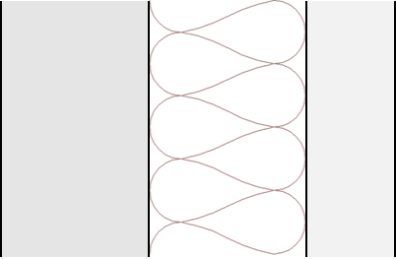
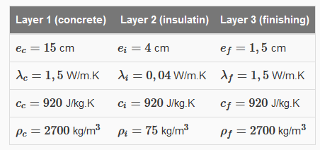
Exercise 1
15/11/17
Solve the exercise on http://ebeclim.org/heat_inertia.html
Simulate the dynamic behaviour of this wall in the following conditions:
initial conditions T=10°C on the whole wall
for t>0 : T_{ext} = 2°C and T_{int} = 19°C
> draw the temperature at the concrete-insulation interface with respect to time
<numéro>

Slide 8

Exercise 4 : project
20/11/17 and 24/11/17
Room 1
20 m²
48 m³
Room 2
10 m²
24 m³
Air flow direction
Component | Characteristics
External wall | Area : 31,2 m² (room 1); 15,6 m² (room 2) Transmittance : U= 0,45 W/m².K
Window | Area : 2 m² Transmittance : U= 2,9 W/m².K Solar gain : 42%
Partition wall | Area : 12 m² Transmittance : U= 11 W/m².K
Ventilation rate | 1 vol/h
Find the heating power required to maintain 19°C in the room for an average outdoor temperature of 9°C
Simulate the transient temperature of room 1 and 2, using the outdoor temperature from the data file
<numéro>

Slide 9

<numéro>

